Slide 1
AZ-104T00A Administer Governance and Compliance

Slide 2


Administer Governance and Compliance Introduction
Configure Subscriptions
Configure Azure Policy
Configure Role-Based Access Control
Lab 02a - Manage Subscriptions and RBAC
Lab 02b - Manage Governance via Azure Policy
Lab 03a – Manage Azure resources with the Azure portal
Notes:
Moved Lab 03a – Manage Azure resources with the Azure portal into this module. It covers resource locks.

Slide 3
Configure Subscriptions and Configure Azure Resource Manager Resources

Slide 4





Configure Subscriptions Introduction
Identify Regions
Implement Azure Subscriptions
Identify Subscription Usage
Obtain a Subscription
Create Resource Groups
Determine Resource Limits
Create an Azure Resource Hierarchy
Apply Resource Tagging
Manage Costs
Summary and Resources
Notes:
Manage Azure identities and governance (15-20%)
Manage subscriptions and governance
• Manage subscriptions
• Configure Cost Management

Slide 5
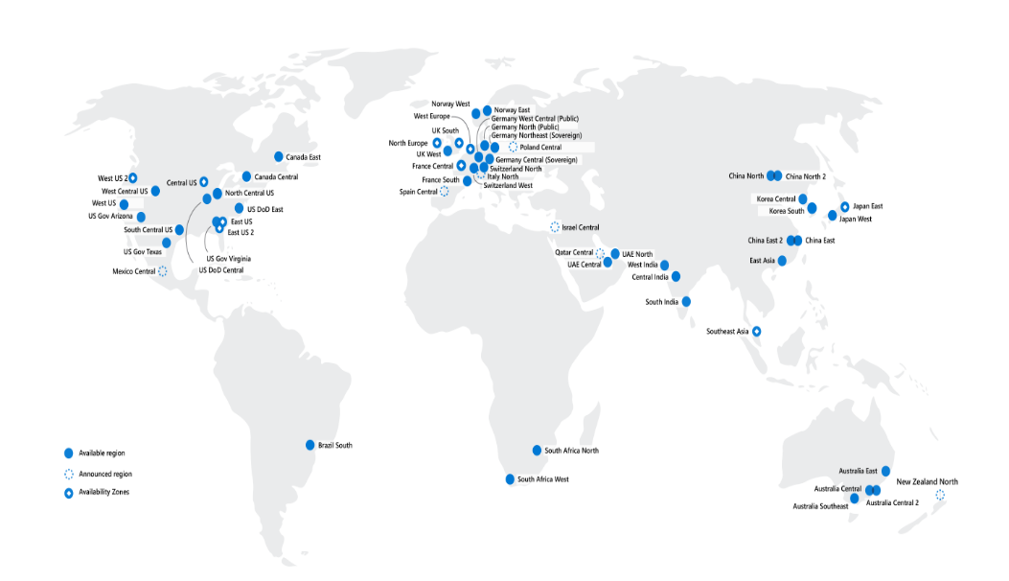
Identify Regions
A region represents a collection of datacenters
Provides flexibility and scale
Preserves data residency
Select regions close to your users
Be aware of region deployment availability
There are global services that are region independent
Regions are paired for high availability
Worldwide there are 60+ regions representing 140 countries
Most services are deployed within a region but not all

Slide 6
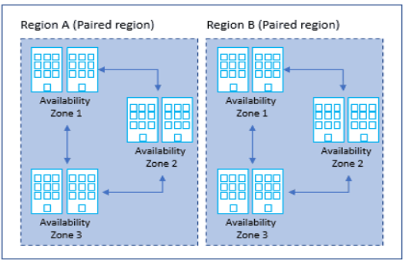

Slide 7
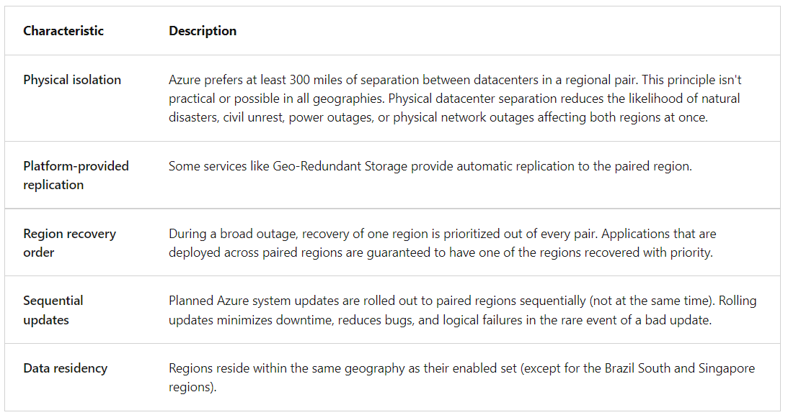

Slide 8
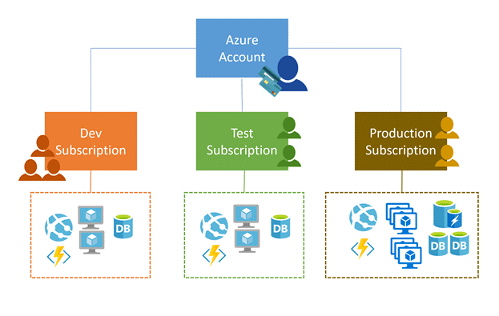
Implement Azure Subscriptions
Only identities in Azure AD, or in a directory that is trusted by Azure AD, can create a subscription
Logical unit of Azure services that is linked to an Azure account
Security and billing boundary
Multiple subscriptions can be linked to the same Azure account.
Billing for Azure services is done on a per-subscription basis.
Notes:
Create an additional Azure subscription - https://docs.microsoft.com/azure/cost-management-billing/manage/create-subscription
Change your Azure subscription to a different offer - https://docs.microsoft.com/azure/cost-management-billing/manage/switch-azure-offer
✔️ Do you know how many subscriptions your organization has?
Clarification on the last bullet - Only Identities in Azure Active Directory (Azure AD) or in a directory that is trusted by Azure AD (such as a work or school organization) can create a Subscription. For example, Account Owner role can be used to create a Subscription in an Enterprise Agreement.

Slide 9
Identify Subscription Usage
Subscription | Usage
Free | Includes a $200 credit for the first 30 days, free limited access for 12 months
Pay-As-You-Go | Charges you monthly
CSP | Agreement with possible discounts through a Microsoft Cloud Solutions Provider Partner – typically for small to medium businesses
Enterprise | One agreement, with discounts for new licenses and Software Assurance – targeted at enterprise-scale organizations
Student | Includes $100 for 12 months – must verify student access
Notes:
Credit card information is used for identity verification only. You won’t be charged for any services until you upgrade.

Slide 10
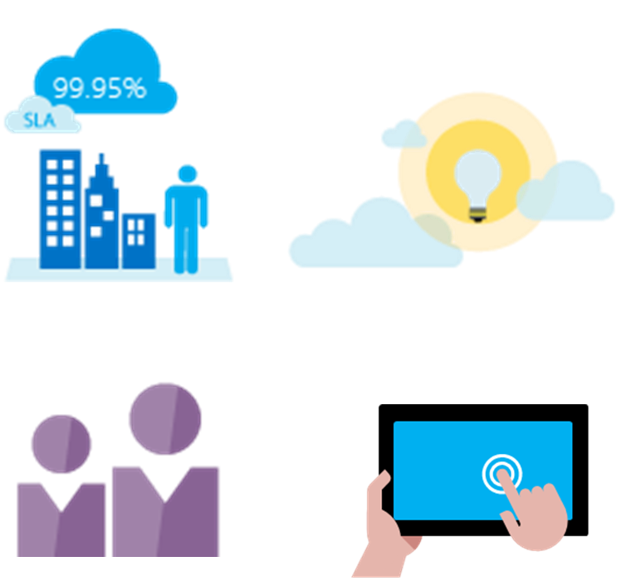
Obtain a Subscription
Enterprise Agreement customers make an upfront monetary commitment and consume services throughout the year
Resellers provide a simple, flexible way to purchase cloud services
Partners can design and implement your Azure cloud solution
Personal free account – Start right away
Notes:
Subscription decision guide - https://docs.microsoft.com/azure/cloud-adoption-framework/decision-guides/subscriptions/
✔️ Which subscription model are you most interested in?

Slide 11
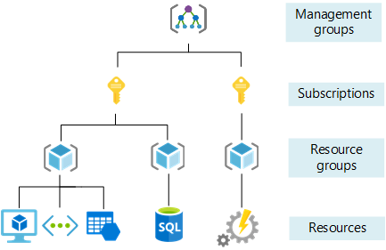
Subscription Best Practices
Consider the types of Azure accounts required
Consider multiple subscriptions
Consider a dedicated shared services subscription
Consider access to resources

Slide 12
Management Groups
By default, all new subscriptions are placed under the top-level management group, or root group
All subscriptions within a management group automatically inherit the conditions applied to that management group
A management group tree can support up to six levels of dept
Azure role-based access control authorization for management group operations isn't enabled by default
Used as administrative boundaries for business units, customers etc

Slide 13
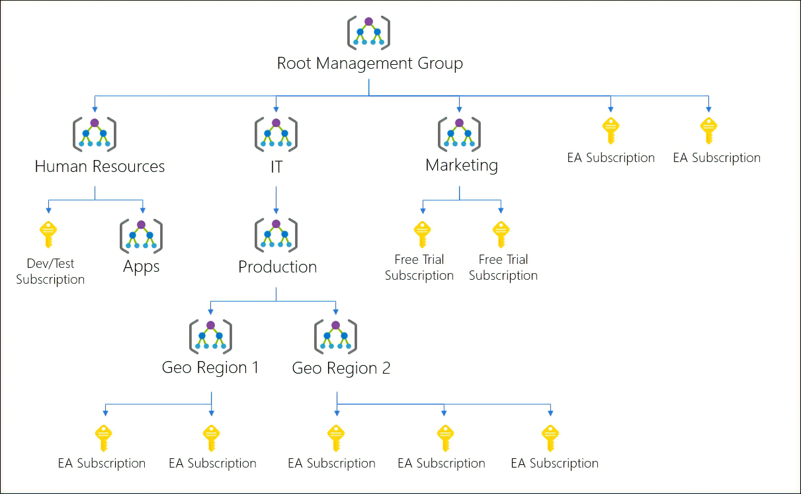

Slide 14
Designing Management Groups
Consider custom hierarchies and groups. Align your Azure subscriptions by using custom hierarchies and grouping that meet your company's organizational structure and business scenarios. You can use management groups to target policies and spending budgets across subscriptions.
Consider policy inheritance. Control the hierarchical inheritance of access and privileges in policy definitions. All subscriptions within a management group inherit the conditions applied to the management group.
Consider compliance rules. Organize your subscriptions into management groups to help meet compliance rules for individual departments and teams.
Consider cost reporting. Use management groups to do cost reporting by department or for specific business scenarios. You can use management groups to report on budget details across subscriptions.

Slide 15
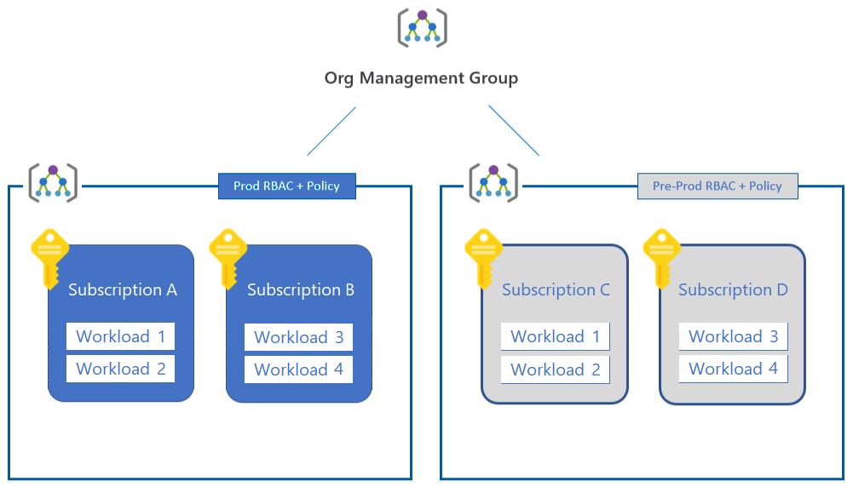

Slide 16
Create Resource Groups
Resources can only exist in one resource group
Resources grouped (Web + DB, VM, Storage) in one group
Groups can have resources of many different types (services) and from many different regions
OR
Groups cannot be renamed or nested
Web and DB resource group
Virtual machine resource group
Storage resource group
Resource locks can prevent changes to the resources
You can move resources between groups
Notes:
Manage Azure Resource Manager resource groups by using the Azure portal - https://docs.microsoft.com/azure/azure-resource-manager/management/manage-resource-groups-portal

Slide 17
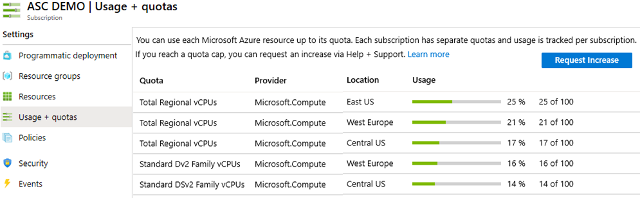
Determine Resource Limits
Resources have a default limit also known as quota
Helpful to track current usage, and plan for future use
You can open a free support case to increase limits to published maximums
Notes:
Azure subscription and service limits, quotas, and constraints - https://docs.microsoft.com/azure/azure-resource-manager/management/azure-subscription-service-limits

Slide 18
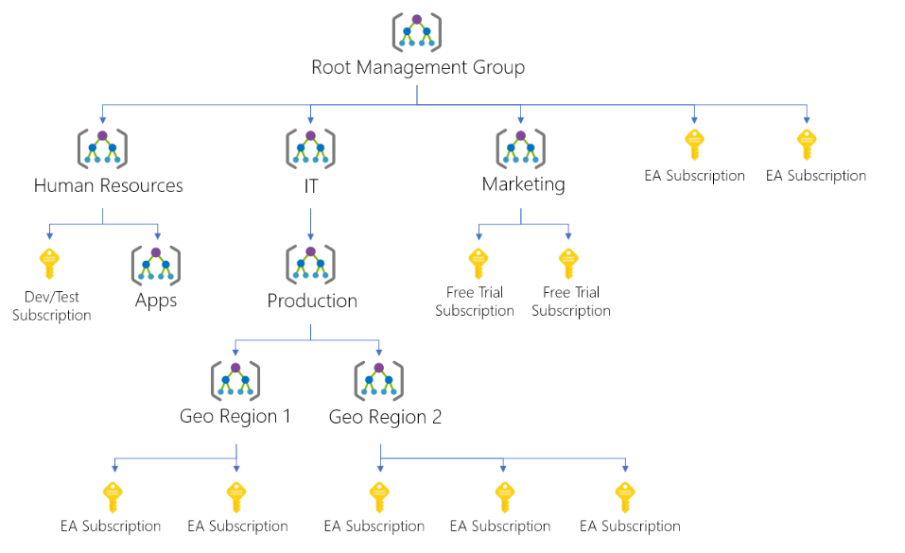
Create an Azure Resource Hierarchy
Management groups provides a level of scope above subscriptions
Target policies and spend budgets across subscriptions and inheritance down the hierarchies
Implement compliance and cost reporting by organization (business/teams)
Notes:
Create management groups for resource organization and management - https://docs.microsoft.com/azure/governance/management-groups/create
Manage your resources with management groups - https://docs.microsoft.com/azure/governance/management-groups/manage

Slide 19
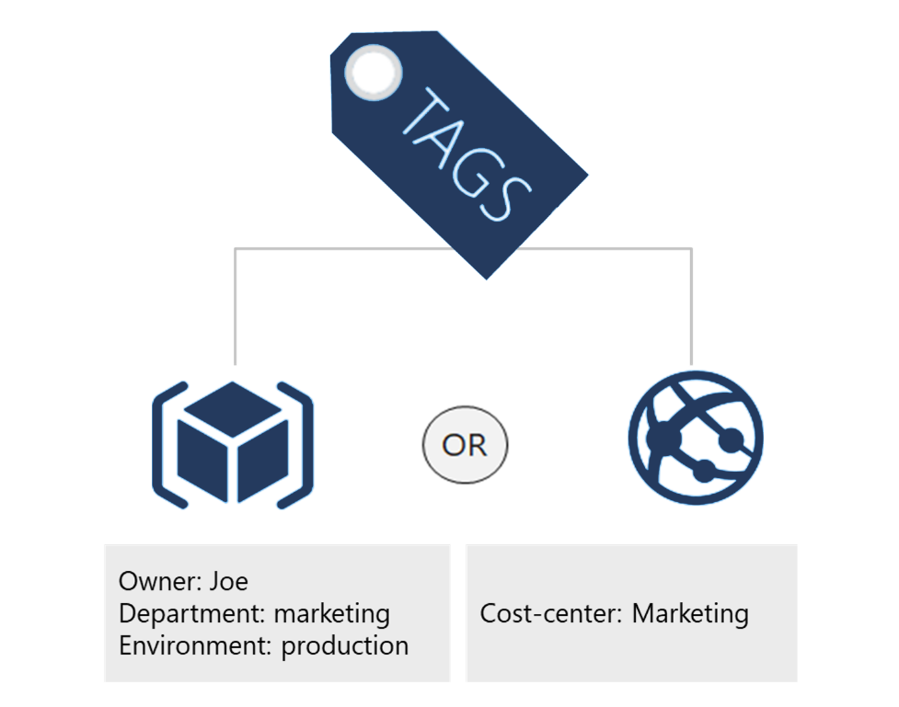
Apply Resource Tagging
Provides metadata for your Azure resources
Logically organizes resources – max 50
Consists of a name-value pair
Very useful for rolling up billing information
Tags applied to a resource group aren't inherited by the resources in the resource group (EXAM TIP).
Notes:
Resource naming and tagging decision guide - https://docs.microsoft.com/azure/cloud-adoption-framework/decision-guides/resource-tagging
✔️ If you need to create a lot of tags you will want to do that programmatically. You can use PowerShell or the CLI.

Slide 20
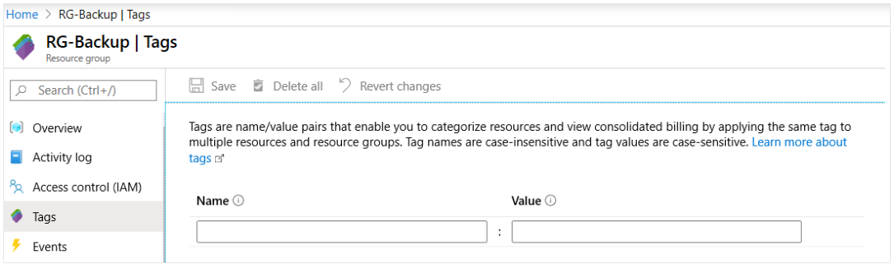
Resource Tags

Slide 21
Why are Resource Groups Useful?
Searching on tag data. Search for resources in your subscription by querying on the tag name and value.
Finding related resources. Retrieve related resources from other resource groups by searching on the tag name or value.
Grouping billing data. Group resources like virtual machines by cost center and production environment.
Creating tags with PowerShell or the Azure CLI. Create many resource tags programmatically by using Azure PowerShell or the Azure CLI.

Slide 22
Implement Cost Management
Conduct cost analysis
Create a budget
Review recommendations
Export the data
Notes:
What is Azure Cost Management and Billing? - https://docs.microsoft.com/azure/cost-management-billing/cost-management-billing-overview
Quickstart: Explore and analyze costs with cost analysis - https://docs.microsoft.com/azure/cost-management-billing/costs/quick-acm-cost-analysis
Analyze costs and create budgets with Azure Cost Management - https://docs.microsoft.com/learn/modules/analyze-costs-create-budgets-azure-cost-management/

Slide 23
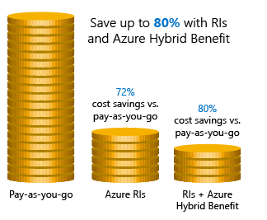
Apply Cost Savings
Azure Reservations – Helps you save money by pre-paying for services
Azure Hybrid Benefits – Use Windows Server and SQL Server on-premises licenses with Software Assurance
Azure Credits – Monthly credit benefit that allows you to experiment with, develop, and test new solutions on Azure
Regions – Choose low-cost locations and regions
Notes:
Cost savings - https://docs.microsoft.com/learn/modules/predict-costs-and-optimize-spending/4-save-on-infrastructure-costs

Slide 24
Manage Costs
Costs are resource-specific
Usage costs may vary between locations
Costs for inbound and outbound data transfers differ
Pre-pay with Azure reserved instances
Use your on-premises licenses with Azure Hybrid Benefit
Optimize with alerts, budgets, and recommendations
Notes:
Azure usage charges - https://docs.microsoft.com/azure/billing/billing-understand-your-invoice
There are six primary factors affecting costs:
Resource Type: Costs are resource-specific, so the usage that a meter tracks and the number of meters associated with a resource depend on the resource type.
Services: Azure usage rates and billing periods can differ between Enterprise, Web Direct, and CSP customers.
Location: The Azure infrastructure is globally distributed, and usage costs might vary between locations that offer Azure products, services, and resources.
Bandwidth: Some inbound data transfers are free, such as data going into Azure datacenters. For outbound data transfers, such as data going out of Azure datacenters, pricing is based on Zones.
Azure Reservations: Azure Reservations allow you to prepay for one-year or three-years of virtual machine or SQL Database compute capacity. Pre-paying will allow you to get a discount on the resources you use. Azure reservations can significantly reduce your virtual machine or SQL database compute costs — up to 72 percent on pay-as-you-go prices with one-year or three-year upfront commitment. Reservations provide a billing discount and don't affect the runtime state of your virtual machines or SQL databases.
Azure Hybrid Benefit: If you already have Windows Server or SQL Server licenses in your on-premises deployments, you can use the Azure Hybrid Benefit program to save in Azure. With the Windows Server benefit, each license covers the cost of the OS (up to two virtual machines), and you only pay for base compute costs. You can use existing SQL Server licenses to save up to 55 percent on vCore-based SQL Database options. Options include SQL Server in Azure Virtual Machines and SQL Server Integration Services.

Slide 25
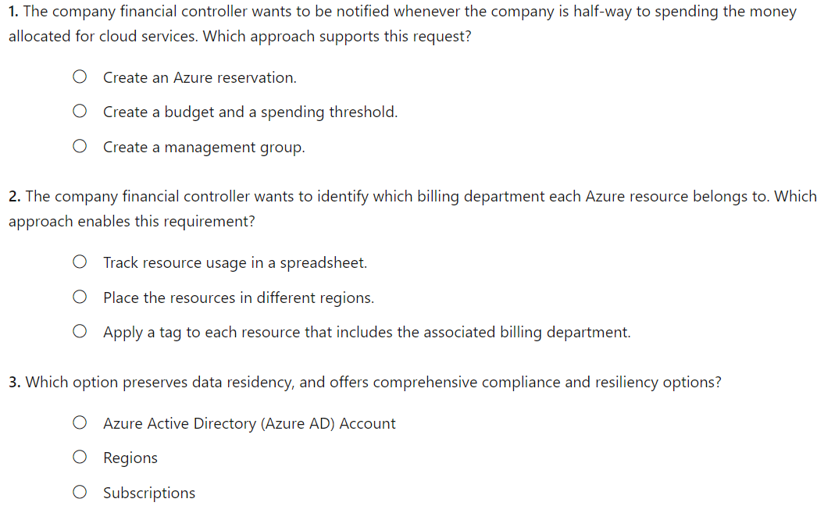
Knowledge Check

Slide 26
Summary and Resources - Configure Subscriptions
Knowledge Check Questions
Microsoft Learn Modules (docs.microsoft.com/Learn)
Introduction to analyzing costs and creating budgets with Azure Cost Management
Plan and manage your Azure costs (Sandbox)
Control and organize Azure resources with Azure Resource Manager
A sandbox indicates a hands-on exercise.
Notes:
Learn - https://docs.microsoft.com/learn/browse/
The Assessment Guide in the MCT DLC has open-ended questions.
What is resource tagging and why would you use it?
Answer: Resource tags provide metadata for your Azure resources. Tags are name-value pairs that help logically organize resources into a taxonomy. Tags can be used to roll up billing information, for example the costs on a new project. Tags can also be used by Azure policy to determine when a policy should be applied.
Name several ways you can reduce costs in Azure
Answer: Azure Reservations helps you save money by pre-paying for services. Azure Hybrid Benefits uses Windows Server and SQL Server on-premises licenses with Software Assurance. Azure Credits provides a monthly benefit that allows you to experiment with, develop, and test new solutions on Azure. Regional pricing can be explored to find the most cost-effective location. You can implement Cost Management to conduct a cost analysis, create a budget, and review cost recommendations.

Slide 27
Configure Azure Policy

Slide 28
Configure Azure Policy Introduction
Implement Azure Policy
Create Azure Policies
Demonstration – Azure Policies
Create Policy Definitions
Create and Scope the Initiative Definition
Determine Compliance
Summary and Resources
Notes:
Manage Azure identities and governance (15-20%)
Manage subscriptions and governance
Configure Azure policies
Apply tags
Configure management groups

Slide 29
Implement Azure Policies
A service in Azure that enables you to create, assign, and manage policies to control or audit your resources.
Usage Cases
Allowed resource types – Specify the resource types that your organization can deploy
Allowed virtual machine SKUs – Specify a set of virtual machine SKUs that your organization can deploy
Allowed locations – Restrict the locations your organization can specify when deploying resources
Require tag and its value – Enforces a required tag and its value
Azure Backup should be enabled for Virtual Machines – Audit if Azure Backup service is enabled for all Virtual machines
A service to create, assign, and manage policies
Runs evaluations and scans for non-compliant resources
Advantages:
Enforcement and compliance
Apply policies at scale
Remediation
Notes:
What is Azure Policy? - https://docs.microsoft.com/azure/governance/policy/overview
Quickstart: Create a policy assignment to identify non-compliant resources - https://docs.microsoft.com/azure/governance/policy/assign-policy-portal

Slide 30
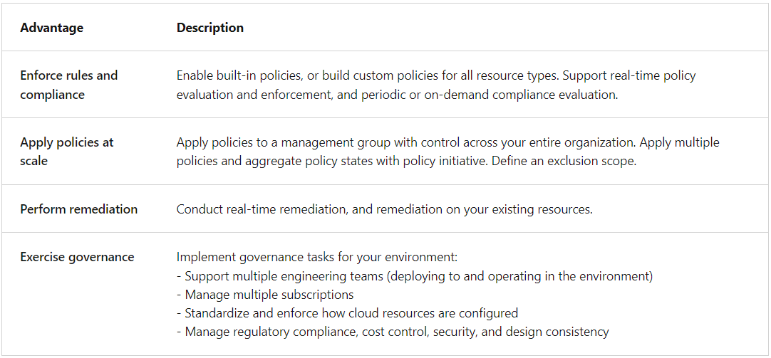
Azure Policy : Types and Use Cases

Slide 31
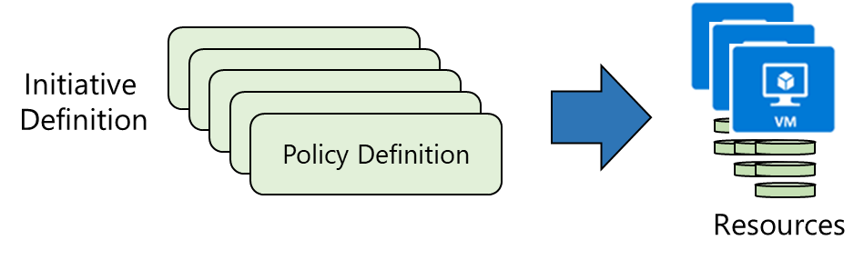
Create Azure Policies
Create Policy Definitions
Create Initiative Definitions
Scope the Initiative Definition
Management Group, Subscription or Resource Group
Determine Compliance
Notes:
Walk-through the Tutorial: Create and manage policies to enforce compliance - https://docs.microsoft.com/azure/governance/policy/tutorials/create-and-manage
Or do the Demonstration (in the MCT DLC).
Or just walk through the slides.
Apply and monitor infrastructure standards with Azure Policy (Learn) - https://docs.microsoft.com/learn/modules/intro-to-governance/
The next topics step you through creating an Azure policy.
✔ Even if you have only a few Policy Definitions, we recommend creating an Initiative Definition.

Slide 32
Demonstration – Azure Policy
Assign a policy
Create and assign an initiative definition
Check for compliance
Check for remediation tasks
Remove your policy and initiative
Notes:
✔ Always consider having students walk-through the demonstrations themselves. Also, consider the overlap with the formal labs and your best use of time.

Slide 33
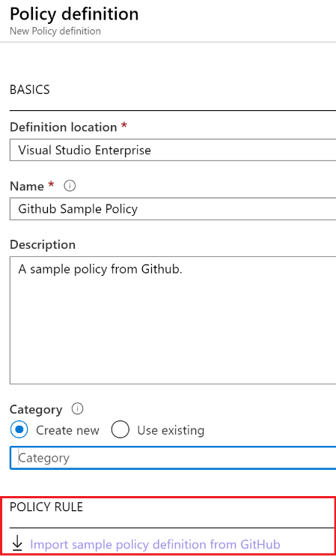
1. Create Policy Definitions
Many policy definitions are available
You can import policies from GitHub
Policy Definitions have a specific JSON format
You can create custom policy definitions
Notes:
Azure Policy built-in policy definitions - https://docs.microsoft.com/azure/governance/policy/samples/built-in-policies
✔️ Policy Definitions have a specific JSON format. As an Azure Administrator you will not need to create files in this format, but you may want to review, so you are familiar. Review the available definitions in the portal and in GitHub.

Slide 34
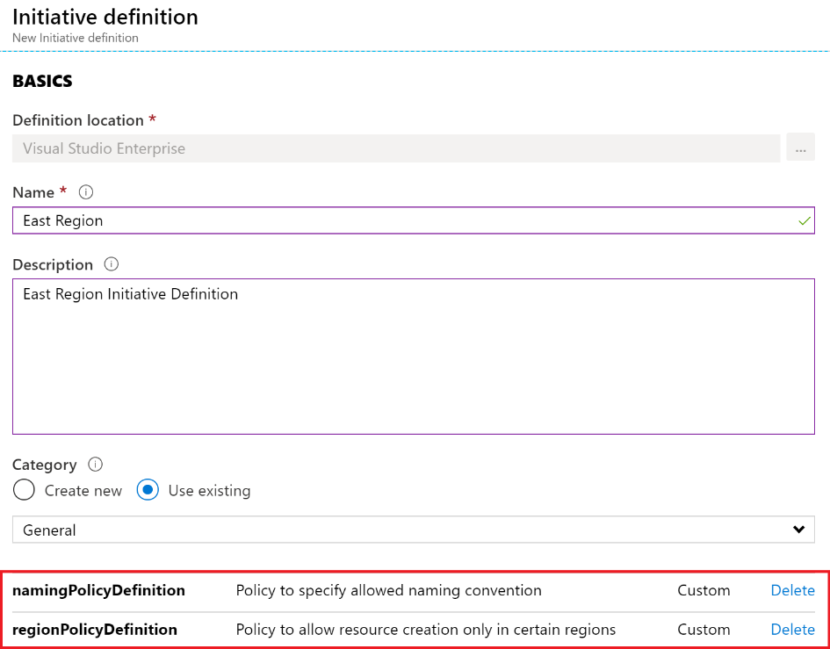
2. Create Initiative Definitions
Group policy definitions
Include one or more policies
Requires planning
Notes:
Azure Policy built-in initiative definitions - https://docs.microsoft.com/azure/governance/policy/samples/built-in-initiatives
✔️ Can you see how this will require some planning to organize your policies?

Slide 35
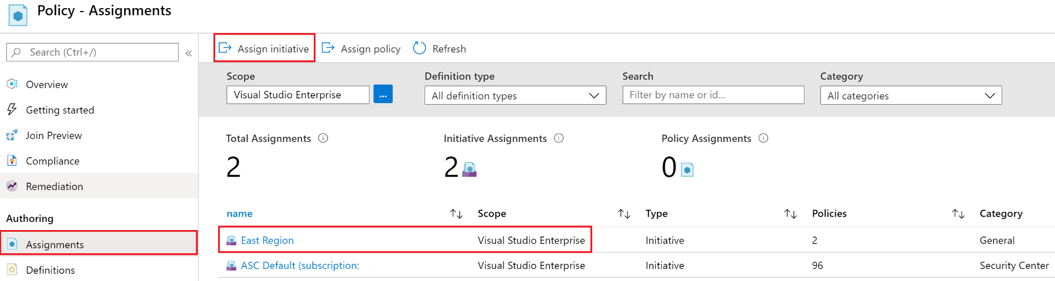
3. Scope the Initiative Definition
Assign the definition to a scope
The scope enforces the policy
Select the subscription, and optionally the resource group

Slide 36
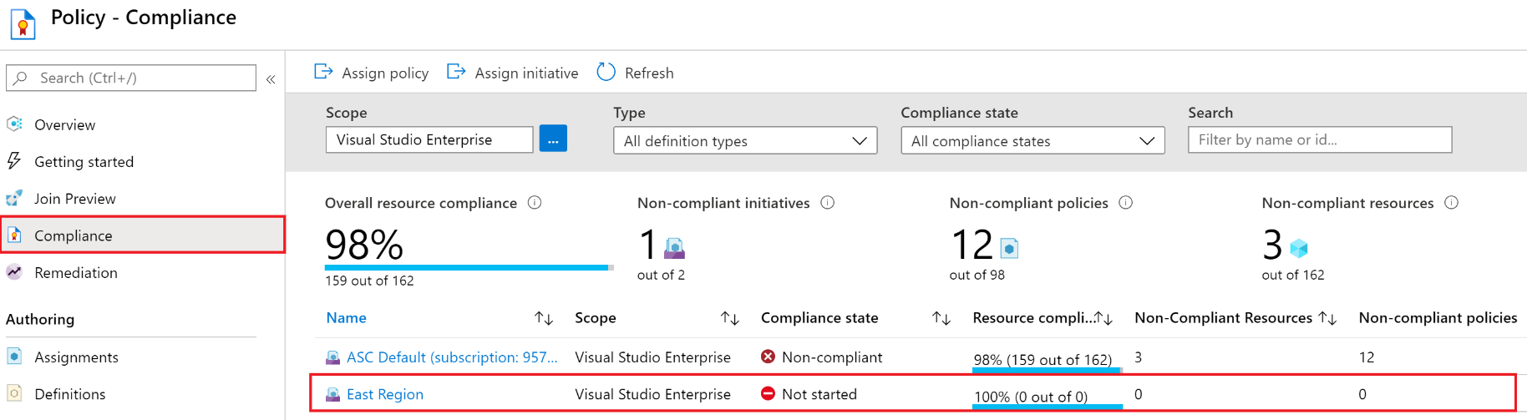
4. Determine Compliance
Non-compliant initiatives, policies and resources
Evaluates and reports about once an hour
Automatic remediations is available
Notes:
✔️ Policy evaluation happens about once an hour, which means that if you make changes to your policy definition and create a policy assignment then it will be re-evaluated over your resources within the hour.

Slide 37
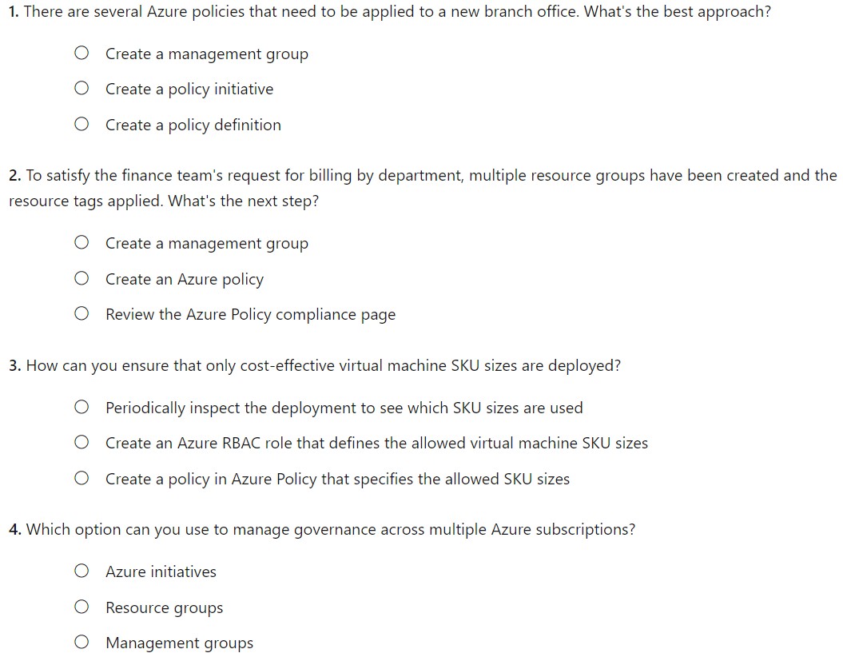
Knowledge Check

Slide 38
Summary and Resources – Configure Azure Policy
Knowledge Check Questions
Microsoft Learn Modules (docs.microsoft.com/Learn)
Introduction to Azure Policy
Build a cloud governance strategy on Azure
Notes:
Learn - https://docs.microsoft.com/learn/browse/
The Assessment Guide in the MCT DLC has open-ended questions.
Describe the steps for creating an Azure policy. What are the advantages of Azure policy?
Answer: Azure Policy is a service in Azure which allows you create polices which enforce and control the properties of a resource. The advantages include enforcement and compliance, applying policies at scale, and remediating non-compliant resources. The creation steps are - create a policy definition, create a policy initiative, scope the initiative, and determine compliance. A policy example is when company wants to implement geographic compliance requirements to limit locations where services can be deployed.

Slide 39
Configure Role-Based Access Control

Slide 40
Configure Role-Based Access Control Introduction
Compare Azure RBAC Roles to Azure AD Roles
Create a Role Definition
Create a Role Assignment
Apply RBAC Authentication
Demonstration – Azure RBAC
Summary and Resources
Notes:
Manage Azure identities and governance (15-20%)
Manage role-based access control (RBAC)
Create a custom role
Provide access to Azure resources by assigning roles (subscriptions, resource groups. resources)
Interpret access assignments

Slide 41

Compare Azure RBAC Roles to Azure AD Roles
RBAC roles provide fine-grained access management
Azure RBAC roles | Azure AD roles
Manage access to Azure resources | Manage access to Azure AD objects
Scope can be specified at multiple levels Roles such as Owner, Contributor | Scope is at the tenant level Roles as as Global Administrator, VM Administrator
Role information can be accessed in the Azure portal, Azure CLI, Azure PowerShell, Azure Resource Manager templates, REST API | Role information can be accessed in Azure portal, Microsoft 365 admin portal, Microsoft Graph, Azure Active Directory PowerShell for Graph
There are many built-in roles, or you can create your own custom role

Slide 42
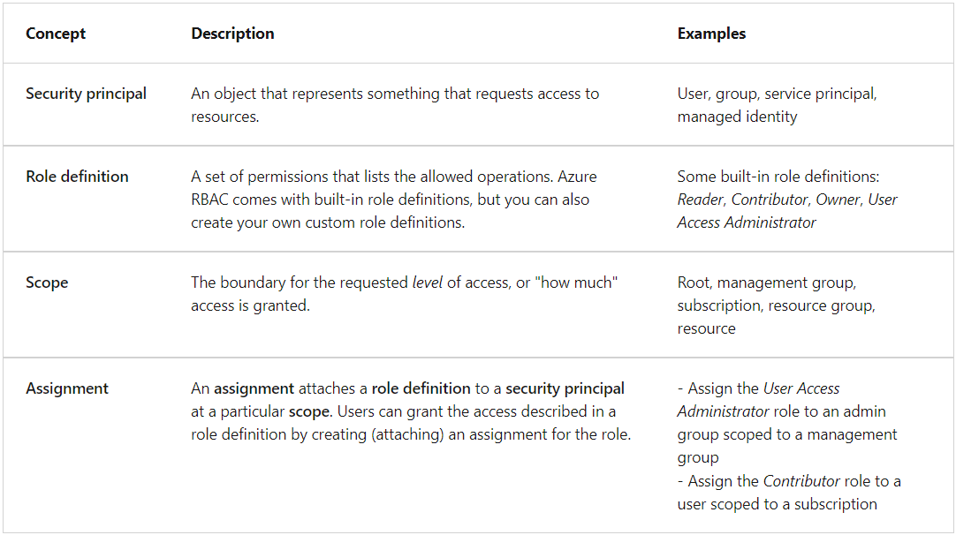
Azure RBAC Concepts

Slide 43
Create a Role Definition
Collection of permissions that lists the operations that can be performed
Contributor
Owner
Contributor
Reader
…
Backup Operator
Security Reader
User Access Administrator
Virtual Machine Contributor
"Actions": [
"*"
],
"NotActions" : [
"Authorization/*/Delete",
"Authorization/*/Write",
"Authorization/elevateAccess/Action"
],
"DataActions" : [],
"NotDataActions": [],
"AssignableScopes" : [
"/"
]
Built-in
Reader Support Tickets
Virtual Machine Operator
Custom
Notes:
List role definitions in Azure RBAC - https://docs.microsoft.com/azure/role-based-access-control/role-definitions-list
Create custom roles for Azure resources with role-based access control - https://docs.microsoft.com/learn/modules/create-custom-azure-roles-with-rbac/

Slide 44
RBAC Role Definition Actions
Actions permissions identify what actions are allowed.
NotActions permissions specify what actions aren't allowed.
DataActions permissions indicate how data can be changed or used.
AssignableScopes permissions list the scopes where a role definition can be assigned.
Notes:
The Actions permissions show the Contributor role has all action privileges. The asterisk "*" wildcard means "all." The NotActions permissions narrow the privileges provided by the Actions set, and deny three actions:
Authorization/*/Delete: Not authorized to delete or remove for "all."
Authorization/*/Write: Not authorized to write or change for "all."
Authorization/elevateAccess/Action: Not authorized to increase the level or scope of access privileges.

Slide 45
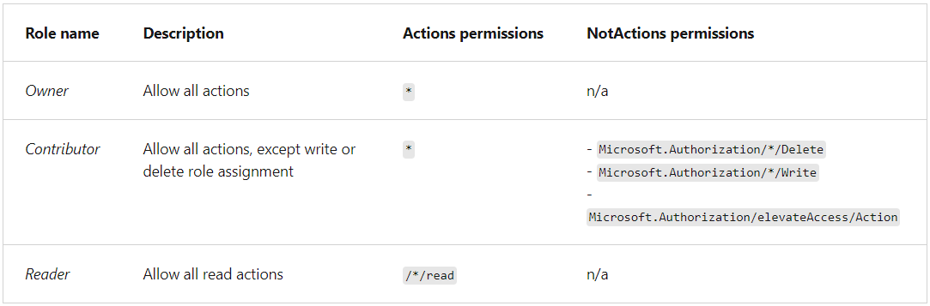
Role Permission Sets

Slide 46
Azure Resource RBAC Things to Remember
Azure RBAC provides built-in roles and permissions sets. You can also create custom roles and permissions. These are defined in JSON.
The Owner built-in role has the highest level of access privilege in Azure. Contributor is the second highest access level.
The system subtracts NotActions permissions from Actions permissions to determine the effective permissions for a role.
Azure RBAC is an additive model, so your effective permissions are the sum of your role assignments.
The AssignableScopes permissions for a role can be management groups, subscriptions, resource groups, or resources.

Slide 47
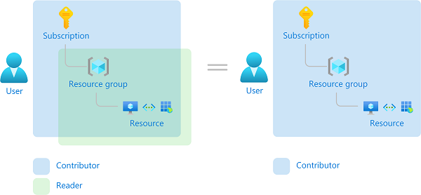
Example of Effective Permissions with Additive Model
Notes:
Consider the following example where a user is granted the Contributor role at the subscription scope and the Reader role on a resource group. The sum of the Contributor permissions and the Reader permissions is effectively the Contributor role for the subscription. Therefore, in this case, the Reader role assignment has no impact.

Slide 48
Azure RBAC Role Assignments
The purpose of a role assignment is to control access.
The scope limits which permissions defined for a role are available for the assigned requestor.
Access is revoked by removing a role assignment.
A resource inherits role assignments from its parent resource.
The effective permissions for a requestor are a combination of the permissions for the requestor's assigned roles, and the permissions for the roles assigned to the requested resources.

Slide 49




Create a Role Assignment
Process of binding a role definition to a user, group, or service principal at a scope for the purpose of granting access
1
Security principal
User
Group
Service principal
2
Role definition
Role assignment
3
Scope
Owner
Contributor
Reader
…
Backup Operator
Security Reader
Contributor
"Actions": [
"*"
],
"NotActions": [
"Auth/*/Delete",
"Auth/*/Write",
"Auth/elevate"
]
Management group
Marketing group
Subscription
Resource group
Pharma-sales Resource group
Reader Support Tickets
Virtual Machine Operator
Contributor
Resource
Notes:
This scenario has the following access management configuration:
Three security principals are supported: user, group, service principal.
Six built-in roles are implemented, and two custom roles are defined: Reader Support Tickets and Virtual Machine Operator.
The built-in Contributor role has two sets of permissions: Actions and NotActions.
The Contributor role is assigned at different scopes to the Marketing group and Pharma-sales resource group:
Users in the Marketing group are granted access to create or manage any Azure resource in the Pharma-sales resource group.
Marketing users aren't granted access to resources outside the Pharma-sales resource group, unless they have another role assignment that grants them access to the resource group.

Slide 50
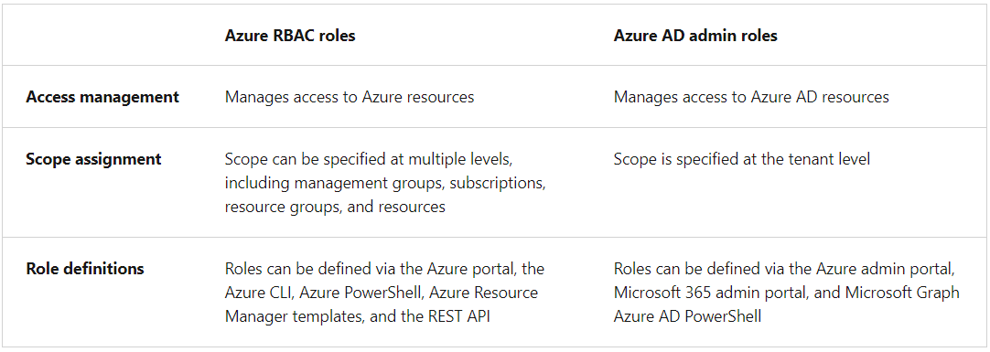
Reminder: Compare Azure RBAC with Azure AD Admin

Slide 51





Apply RBAC Authentication
Azure AD
Admin roles
Azure Active
Directory tenant
Global admin
Application admin
Application developer
Billing admin …
Global admin/User access admin (elevated access)
Root
Azure RBAC
roles
Root management group
Owner
Contributor
Reader
User access admin
…
Management group
Subscription
Azure RBAC
roles
Resource group
Azure account
Owner
Contributor
Reader
User access admin
…
Resource
Notes:
Azure AD admin roles are used to manage resources in Azure AD, such as users, groups, and domains. These roles are defined for the Azure AD tenant at the root level of the configuration.
Azure RBAC roles provide more granular access management for Azure resources. These roles are defined for a requestor or resource and can be applied at multiple levels: the root, management groups, subscriptions, resource groups, or resources.

Slide 52
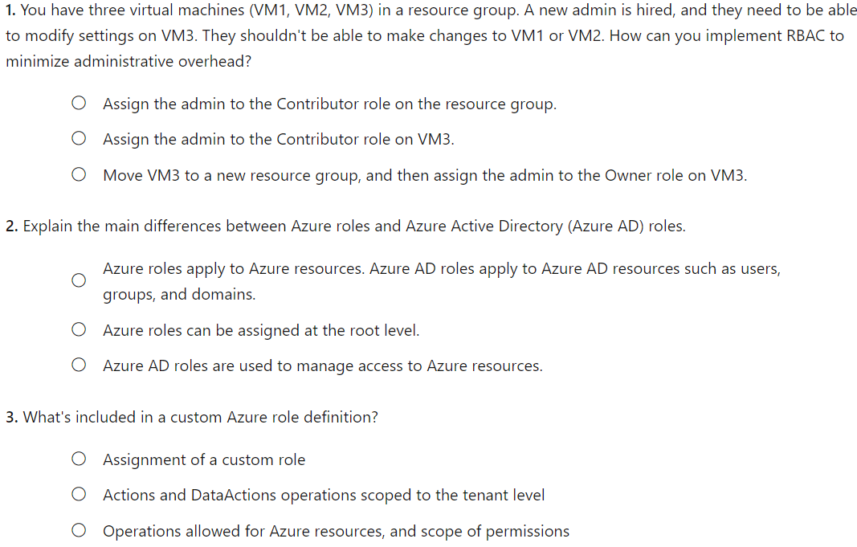
Knowledge Check
Notes:
B – WE CAN APPLY CONTRIBUTOR ROLE TO RESOURCE GROUP OR RESOURCES
A - OBVIOUS
C – Custome roles include ops such as read, write and delete

Slide 53
Demonstration – Azure RBAC
Locate the Access Control blade
Review role permissions
Add a role assignment
Explore PowerShell commands
Notes:
✔ Always consider having students walk-through the demonstrations themselves. Also, consider the overlap with the formal labs and your best use of time.
Use the Demonstration in the MCT DLC or one of the tutorials.
Tutorial: Grant a user access to Azure resources using the Azure portal - https://docs.microsoft.com/azure/role-based-access-control/quickstart-assign-role-user-portal
Quickstart: Check access for a user to Azure resources - https://docs.microsoft.com/azure/role-based-access-control/check-access

Slide 54
Summary and Resources – Configure RBAC
Knowledge Check
Microsoft Learn Modules (docs.microsoft.com/Learn)
Create custom roles for Azure resources with Azure role-based access control
Manage access to an Azure subscription by using Azure role-based access control
Secure your Azure resources with Azure role-based access control (Sandbox)
A sandbox indicates a hands-on exercise.
Notes:
Learn - https://docs.microsoft.com/learn/browse/
The Assessment Guide in the MCT DLC has open-ended questions.
List three RBAC roles and the associated permissions for each role.
Answer: Owner who has full access to all resources and can delegate access to others. Contributor who can creates and manages all types of Azure resources but cannot grant access to others. Reader who can only view Azure resources. User access administrator who manages user access to Azure resources. Other roles are possible.
What is the purpose of role-based access control (RBAC) and why would you use it?
Answer: RBAC provides fine-grained access management of resources in Azure. RBAC can be used to segregate duties within a team. RBAC can also grant just the amount of access users need to perform their jobs​. RBAC is an allow model granting access only as assigned.

Slide 55
Lab 02a - Manage Subscriptions and RBAC Lab 02b - Manage Governance via Azure Policy Lab 03a – Manage Azure resources with the Azure portal
Notes:
Go ahead and cover Lab 03a which includes the portal review and resource locks.

Slide 56
Lab 02a – Manage Subscriptions and Azure RBAC
Lab scenario
To improve the management of Azure resources in Contoso, you have been tasked with implementing the following functionality:
Using management groups for the Contoso’s Azure subscriptions
Granting user permissions for submitting support requests. This user would only be able to create support request tickets and view resource groups
Objectives
Task 1: Implement Management Groups
Task 2: Create custom RBAC roles
Task 3: Assign RBAC roles
Next slide for an architecture diagram
Notes:
LAB 02a - Manage Subscriptions and RBAC - ESTIMATED DURATION 30 MIN
Lab Repository - https://microsoftlearning.github.io/AZ-104-MicrosoftAzureAdministrator/

Slide 57




Lab 02a – Architecture diagram
Task 1
Tenant Root Group
Default Azure AD tenant
az104-02-rg1
Task 2
Task 3
az104-02a-customRoleDefinition.json
{
"Name": "Support Request Contributor (Custom)",
"IsCustom": true,
"Description": "Allows to create support requests",
"Actions": [
"Microsoft.Resources/subscriptions/resourceGroups/read",
"Microsoft.Support/*"
],
"NotActions": [
],
"AssignableScopes": [
"/providers/Microsoft.Management/managementGroups/az104-02-mg1",
"/subscriptions/SUBSCRIPTION_ID"
]
}
Azure pass subscription
az104-02-aaduser1
customRoleDefinition

Slide 58
Lab 02b – Manage Governance via Azure Policy
Lab scenario
To improve management of Azure resources in Contoso, you have been tasked with implementing the following functionality:
Tagging resource groups that include only infrastructure resources
Ensuring that only properly tagged infrastructure resources can be added to infrastructure resource groups
Remediating any non-compliant resources
Objectives
Task 1: Create and assign tags via the Azure portal
Task 2: Enforce tagging via an Azure Policy
Task 3: Apply tagging via an Azure Policy
Next slide for an architecture diagram
Notes:
LAB 02b - Manage Governance via Azure Policy - ESTIMATED DURATION 30 MIN
Lab Repository - https://microsoftlearning.github.io/AZ-104-MicrosoftAzureAdministrator/

Slide 59


Lab 02b – Architecture diagram
Task 1
Name: Role
Value: Infra
Task 2
Cloud Shell Storage
Resource Group
Azure policy
Require a tag and its value on resources
Cloud Shell Storage Account
Task 3
Azure policy
Inherit a tag from the resource group if missing
New Storage Account

Slide 60
Lab 03a – Manage Azure resources with the Azure portal
Lab scenario
You need to explore the basic Azure administration capabilities associated with provisioning resources and organizing them based on resource groups, including moving resources between resource groups. You also want to explore options for protecting disk resources from being accidentally deleted, while still allowing for modifying their performance characteristics and size
Objectives
Task 1: Create resource groups and deploy resources to resource groups
Task 2: Move resources between resource groups
Task 3: Implement and test resource locks
Next slide for an architecture diagram
Notes:
Consider doing this lab now, since resource groups and locks were covered.
LAB 03a - Manage Azure resources by Using the Azure Portal - ESTIMATED DURATION 20 MIN
GitHub Repository - https://microsoftlearning.github.io/AZ-104-MicrosoftAzureAdministrator/

Slide 61


Lab 03a – Architecture diagram
Task 1
Task 2
az104-03a-rg1
az104-03a-rg2
Move resource
az104-03a-disk1
az104-03a-disk1
Task 3
az104-03a-rg3
az104-03a-delete-lock
Type: Delete
az104-03a-disk2

Slide 62

End of presentation

